Slide 1
Survival Analysis
Larissa Conradt
Data Analytics Learning Laboratory DALL
May 2025

Slide 2


Examples: Use of survival analysis
Health care Engineering
Clinical trials: Is a given treatment efficient?
Health care: Does gender, age, ethnicity, deprivation influence patient outcomes?
Engineering: Predict time until machine failure

Slide 3

Dice game
Dice a 6 and you are out of the game
Trial | t0 | t1 | t2 | t3 | t4 | t5 | t6 | t7 | t8
 | Anna | 2 | 4 | 4 | 6
 | Becky | 4 | 3 | 6
 | Chris | 1 | 2 | 4 | 1 | 3 | 4 | 3 | 1
 | David | 3 | 5 | 1 | 5 | 2 | 6
Survivors | 4 | 4 | 4 | 3 | 2 | 2 | 1 | 1 | 1
Failures |  | 0 | 0 | 1 | 2 | 2 | 3 | 3 | 3
Events |  | 0 | 0 | 1 | 1 | 0 | 1 | 0 | 0

Slide 4
Dice game
The one with the lowest score is out of the game
Trial | t0 | t1 | t2 | t3 | t4 | t5 | t6 | t7 | t8
 | Anna | 2 | 4 | 4 | 6
 | Becky | 4 | 3
 | Chris | 1
 | David | 3 | 5 | 1
Not suited for survival analysis
Independence of individual observations

Slide 5
Dice game
Dice a 6 and you are out of the game
After two moves you can come back in again
Trial | t0 | t1 | t2 | t3 | t4 | t5 | t6 | t7 | t8
 | Anna | 2 | 4 | 4 | 6 | - | - | 4 | 2
 | Becky | 4 | 3 | 6 | - | - | 1 | 2 | 6
 | Chris | 1 | 2 | 4 | 1 | 3 | 4 | 3 | 1
 | David | 3 | 5 | 1 | 5 | 2 | 6 | - | -
Not suited for survival analysis
Once you are out you are out

Slide 6
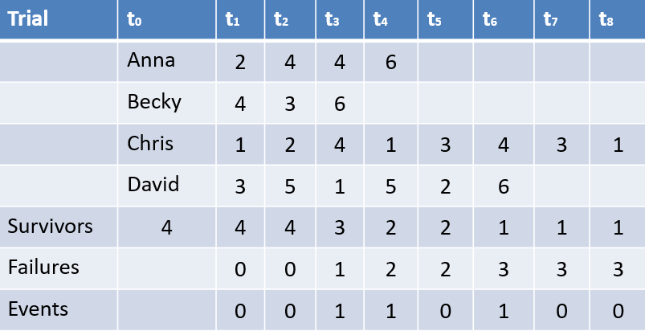
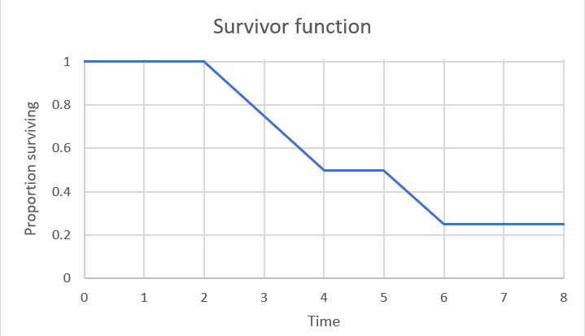
Dice game
Dice a 6 and you are out of the game
Estimate of the probability of survival until at least time t

Slide 7
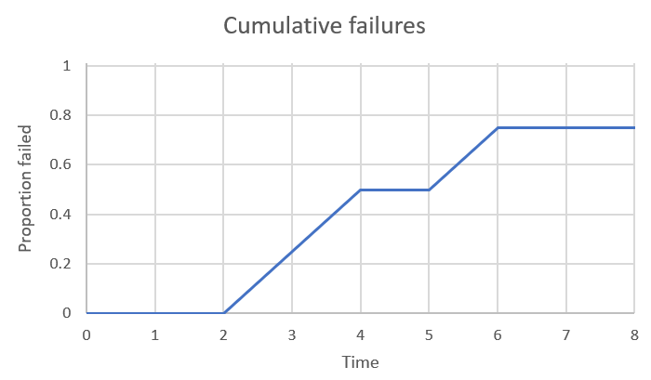
Dice game
Dice a 6 and you are out of the game
Cumulative failure function =
1 – Survival function

Slide 8
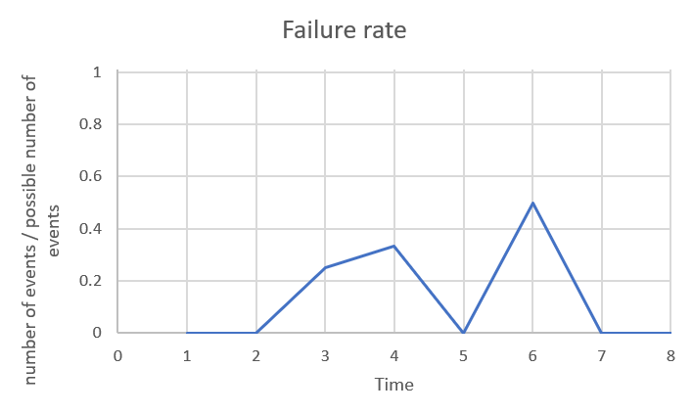
Dice game
Dice a 6 and you are out of the game
Hazard rate
Hazard rate =
Number of failure events / Number of players at risk
Failure rate =
Failure events / Players at risk

Slide 9
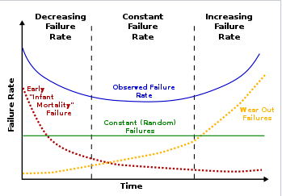
Hazard function
Non-parametric survival analysis:
Kaplan–Meier estimator
Semi-parametric survival analysis:
Cox proportional hazards model
Parametric survival analysis (Maximum Likelihood)
Weibull distribution

Slide 10
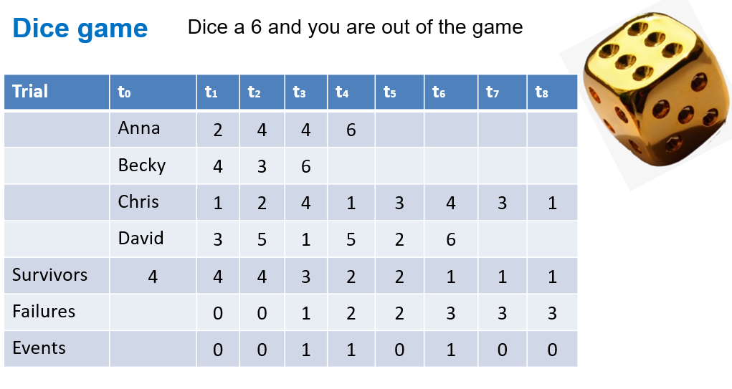
Censuring

Slide 11
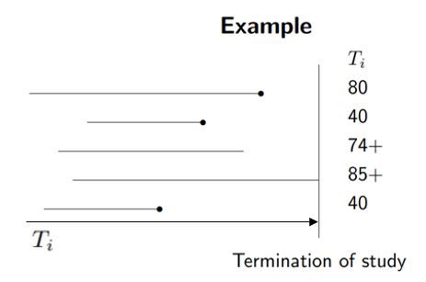
Censuring
Event has not occurred for the participant by the end of the observation period
Participant dropped out of study before her event had occurred
We have some information about a participant’s event time, but we don’t know the exact event time.
Survival of those who are censored must not differ systematically from those who are not censored

Slide 12
Online resources for survival analysis
Theory Survivor Analysis
Introduction to Survival Analysis - Statistical Modeling and Forecasting
Survival Data Analysis (harvard.edu)
HST190_Lecture_8 (harvard.edu)
Intro to Survival Analysis - STA 102: Introduction to Biostatistics (duke.edu)
unit1.pdf (stanford.edu)
Lec5_survival.pdf (washington.edu)
R Survivor analysis
https://whitlockschluter3e.zoology.ubc.ca/RExamples/Rcode_Chapter_21.html#:~:text=First%20we%20run%20Surv(),only%201%20group%20of%20subjects).&text=Finally%2C%20the%20curve%20is%20plotted%20(Figure%2021.1%2D1).
https://devinincerti.com/2019/06/18/parametric_survival.html#:~:text=the%20log%2Dlogistic%20and%20lognormal,increasing%2C%20and%20monotonically%20decreasing%20hazards.
RPubs - Survival Analysis - Lung Dataset
Survival Analysis with R · R Views
https://www.emilyzabor.com/survival-analysis-in-r.html#the-lung-dataset
R package information
https://cran.r-project.org/web/packages/survival/survival.pdf
Survival Analysis Basics | R-bloggers
Video
Introduction to Survival Analysis [1/8] - YouTube

